Slide 1
The Rhetorical Situation
I can define and identify the rhetorical situation in a text or speech.
I have a clear rhetorical situation for my speech.

Slide 2
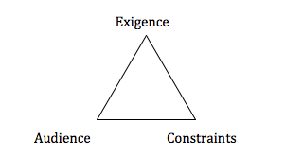
Elements of the Rhetorical Situation
Exigence & Purpose
Audience
Constraints
Message
Message

Slide 3
Exigence & Purpose
Exigence “is used in reference to an issue or situation that leads to demands for rhetoric speech or writing. The term comes from the Latin word for “demand” expect, and also commonly refers to “exigency,” which refers to an urgent need or demand” (Wikipedia).
Purpose refers to what the speaker is trying to get out of their audience, the purpose of writing and giving the speech. They could be trying to persuade listeners, the could be simply informing them, or they could be trying to get them to invest in a product.

Slide 4
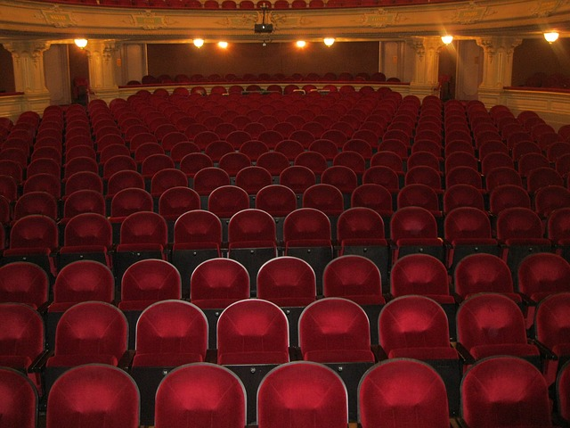
Audience
Audience is to whom the message is crafted for. The way a speaker presents or writes a speech will be determined by the audience’s demographics, size, etc.

Slide 5
Constraints
Constraints are things that affect the choices a speaker or author makes. Simply put, they are the rules of the situation and can be determined by:
The Audience: What are the needs of the audience?
The Speaker: What are my needs as the speaker?

Slide 6
Message
The idea that the speaker or author is trying to get through to the audience. The message is shaped by the exigence, purpose, audience, and constraints.

Slide 7
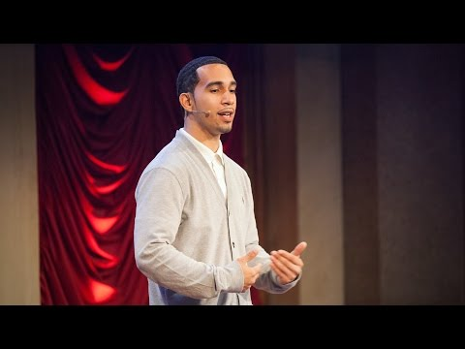
Rhetorical Analysis
Watch the TED Talk by Ismael Nazario, “What I learned as a Kid in Jail,” in order to identify the rhetorical situation.
Exigence- What motivated this speech?
Purpose- What does he want from audience?
Audience- Who is he speaking to?
Constraints- What did Nazario need to consider when writing this speech (about himself and the audience?)
Message- What is the key message he wants his audience to understand?

Slide 8
Process (“How it happens”) Speech
Task Description: You will be giving a 2-3 minute speech that explains the process of something. The topic could be whatever you want, as long as it is related to CEMS.
Example Topics:
How does a black hole work?
How are popsicles made?
Choose a Topic that is:
Interesting to you (you have motivation for speaking on it/exigence)
Appealing to your audience

